Slide 2
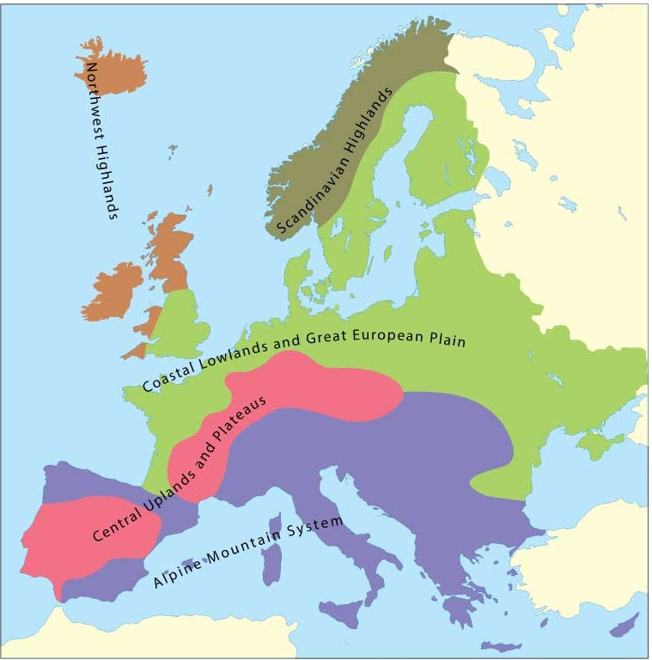
The major physical regions of Europe
The North European Plain stretches from France to Russia

Slide 3
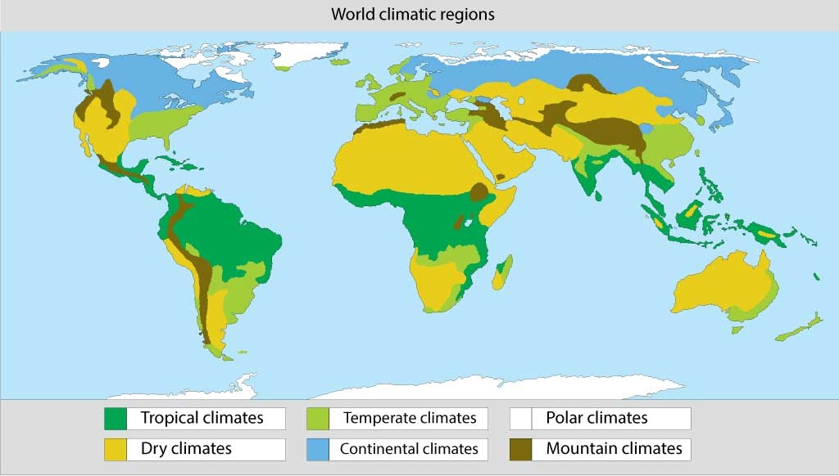
The major climatic regions of the world
There are six major climatic regions

Slide 4
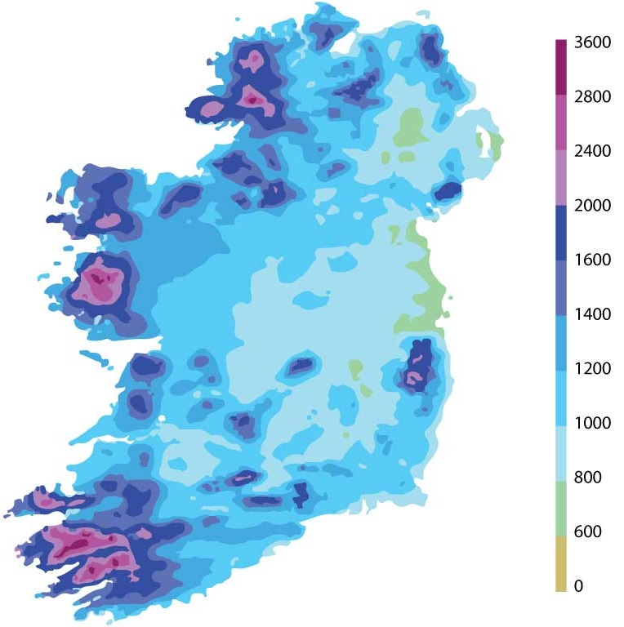
Annual rainfall in Ireland
Ireland has great variations in rainfall from west to east

Slide 5
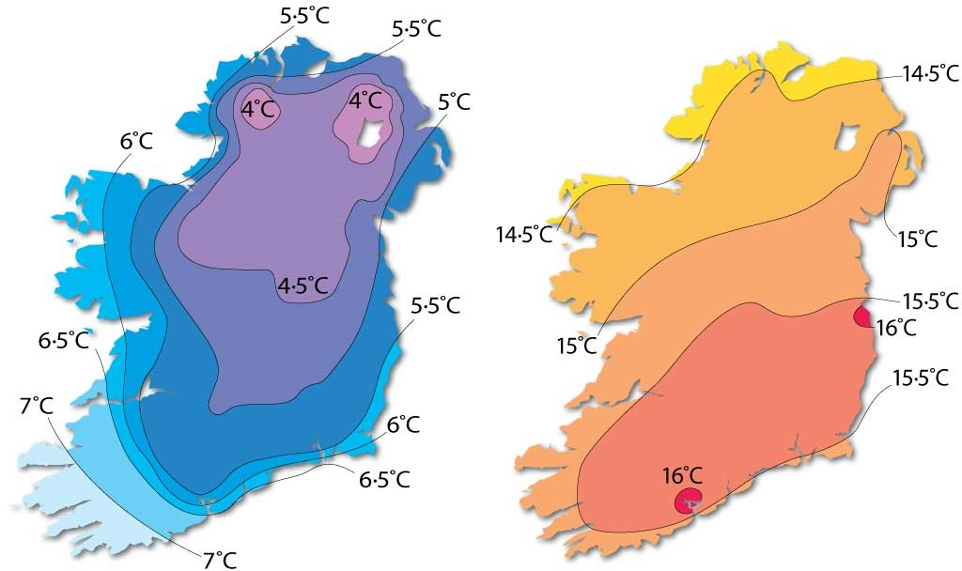
Average air temperatures in Ireland
January (left) and July (right) temperatures in Ireland

Slide 6
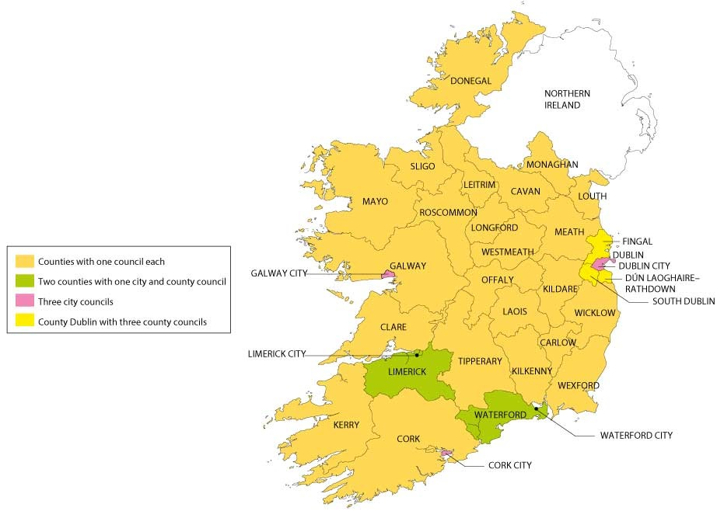
Local government in Ireland
County councils and city councils in Ireland

Slide 7
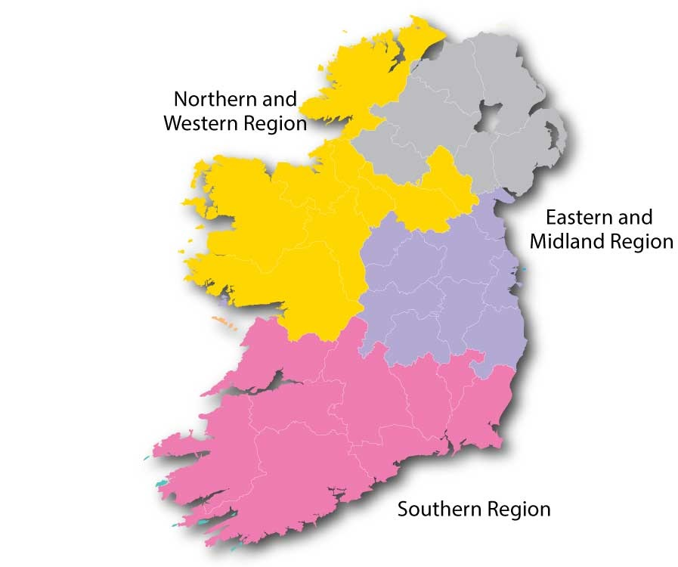
Regional assemblies in Ireland
The Republic of Ireland has three regional assemblies

Slide 8
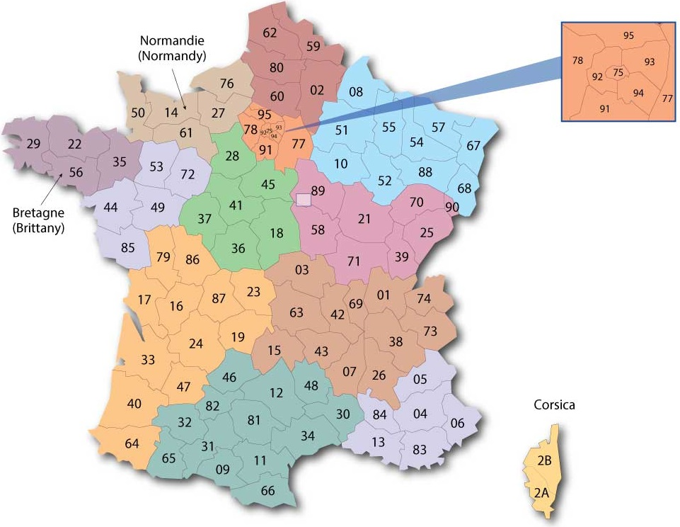
Local government in France
French departements with 13 colour coded regions

Slide 9
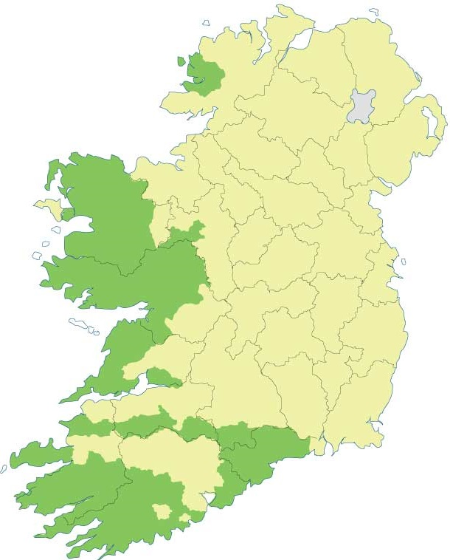
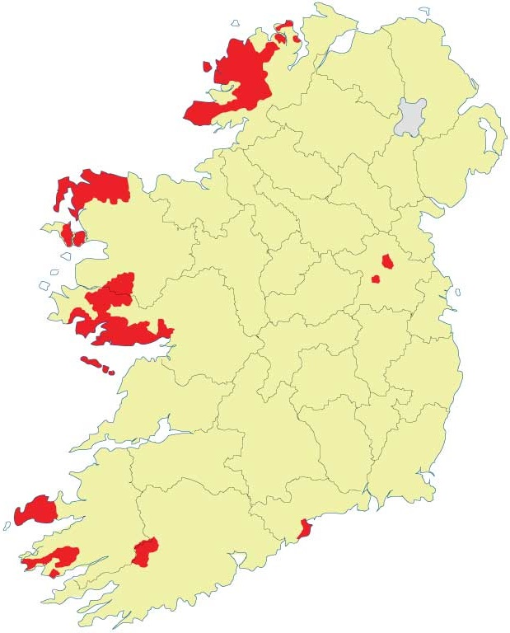
The changing Gaeltacht region
The Gaeltacht in 1851 (left) and today (right)

Slide 10
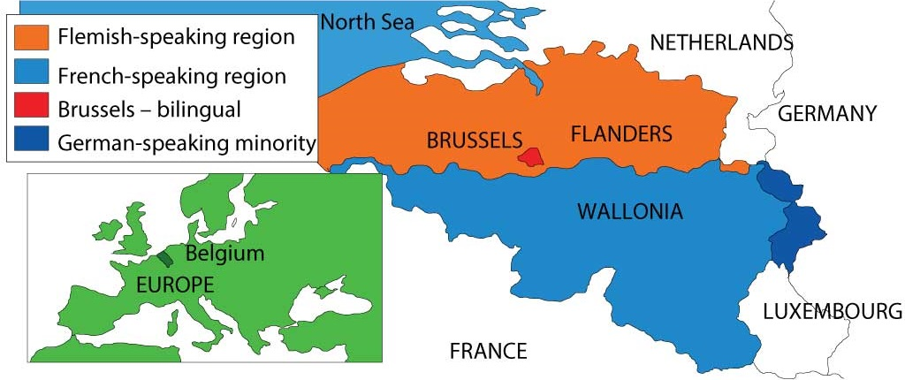
The language regions of Belgium
Belgium is divided on linguistic lines

Slide 11
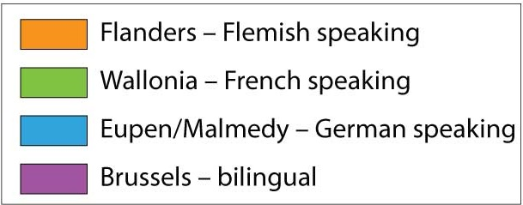
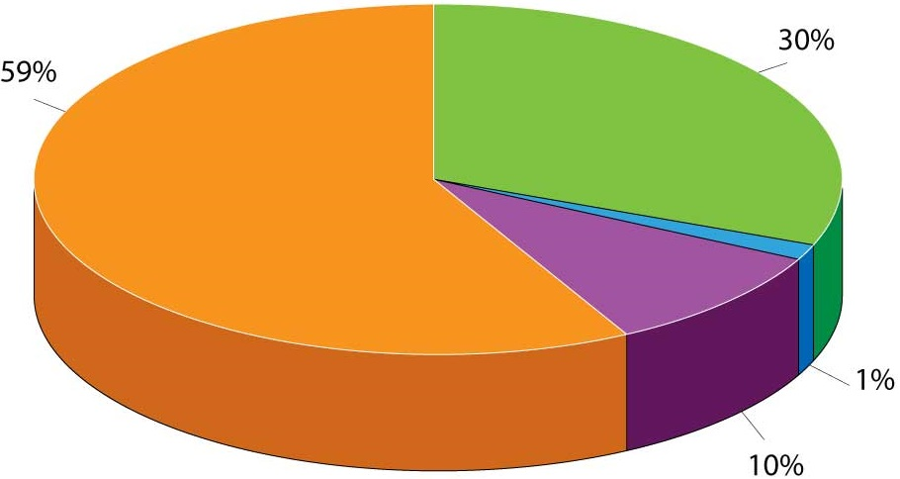
Languages in Belgium
Four languages are spoken in Belgium. A greater percentage
speak Flemish than any other language

Slide 12
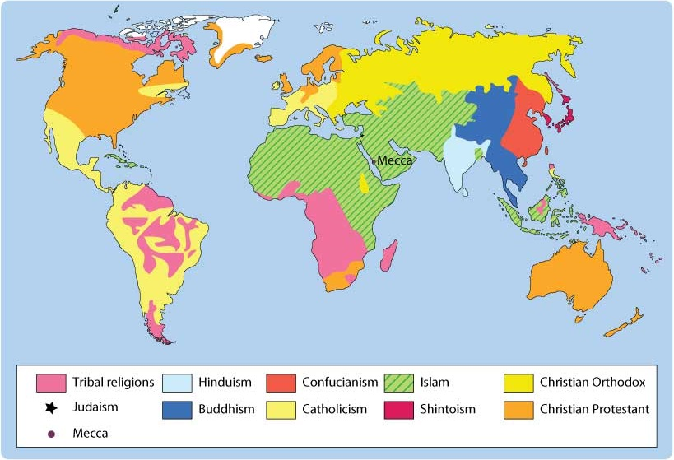
Religious regions of the world
The world has many religions

Slide 13
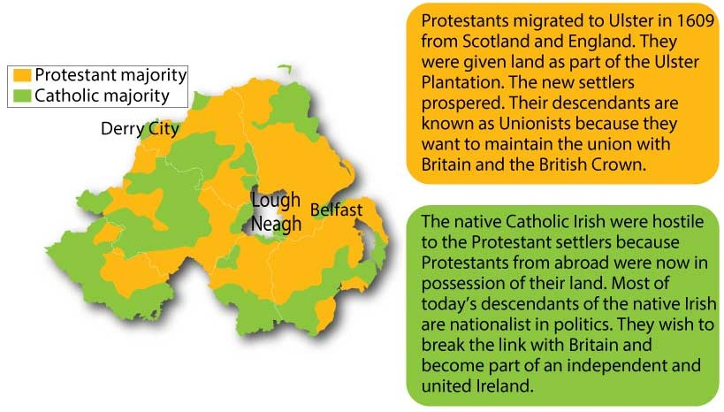
The religious divide in Northern Ireland
Areas with a Protestant majority and a Catholic majority

Slide 14
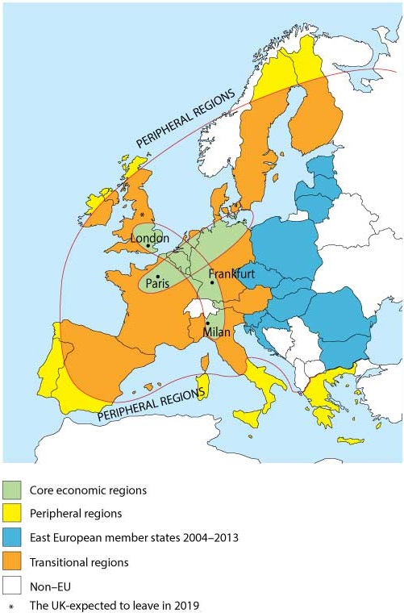
The socio-economic regions of Europe
Europe has core and peripheral regions

Slide 15
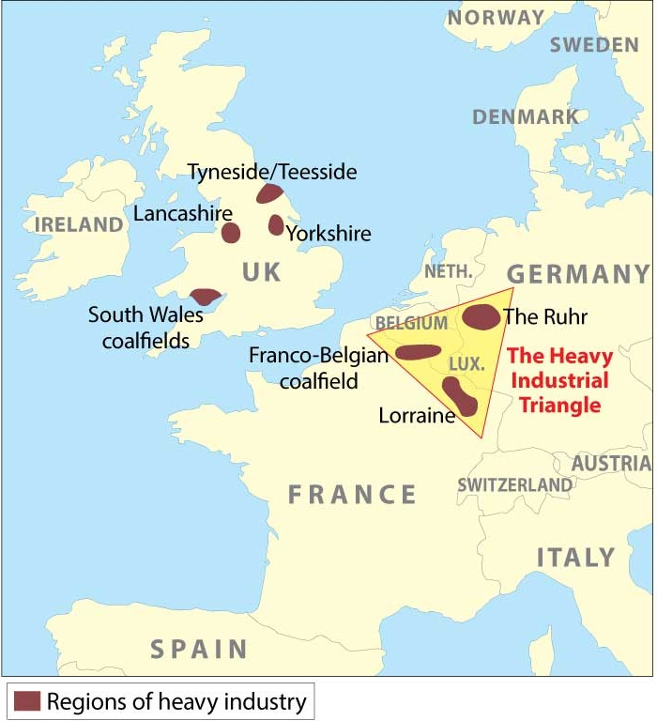
Regions of industrial decline
Regions of industrial decline are found in the UK and in
the Heavy Industrial Triangle in mainland Europe

Slide 16
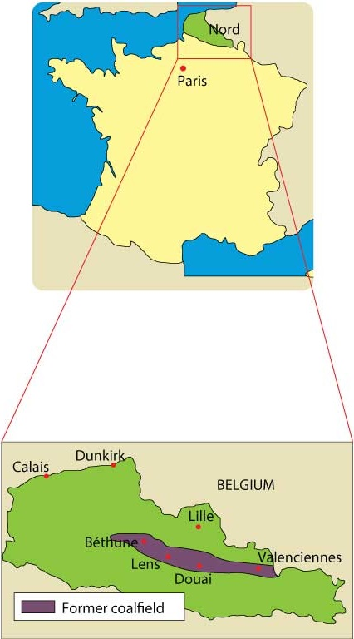
Nord in north-east France
Nord is a region of industrial decline in France

Slide 17
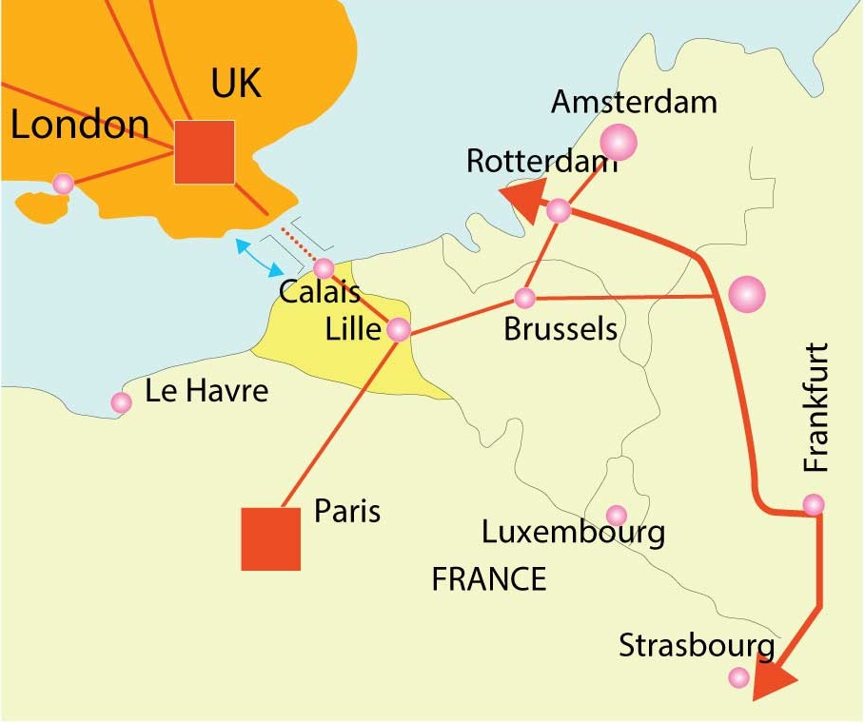
Rail developments around the Lille hub
Lille is centrally located between London, Paris and Rhineland cities

