Slide 2
KEYWORDS
developed world developing world gross national product (GNP) gross domestic product (GDP) | Sub-Saharan Africa informal economy Human Development Index (HDI) | life expectancy primary healthcare gross national income (GNI) remittances

Slide 3
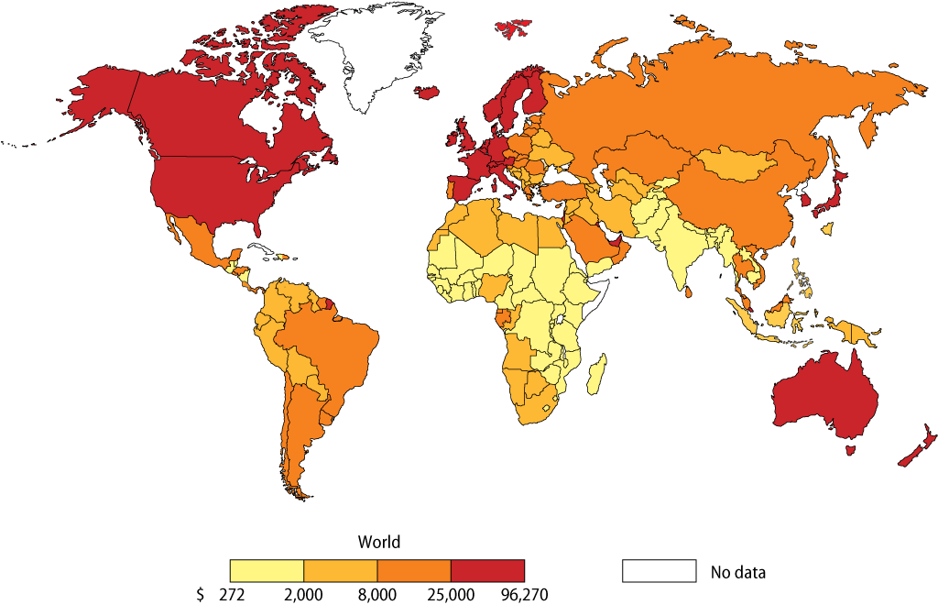
GDP per person per country
GDP varies from country to country across the world

Slide 4
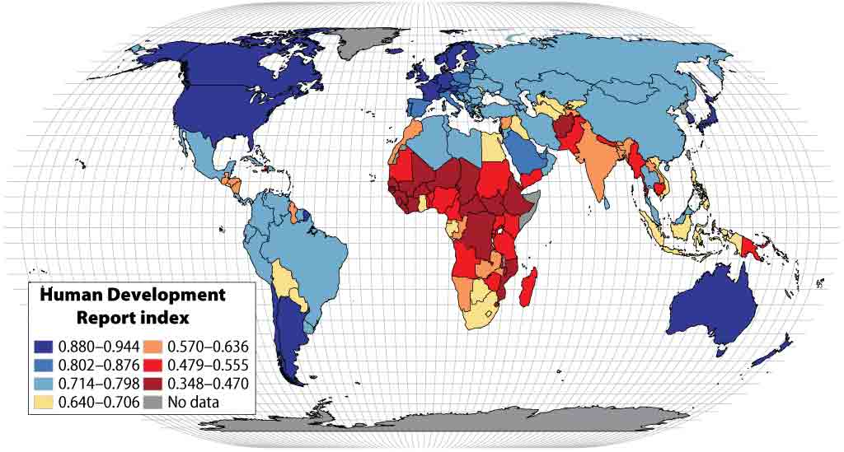
The Human Development Index (HDI)
Sub-Saharan Africa and some countries in South Asia
have the lowest scores in the Human Development Index

Slide 5
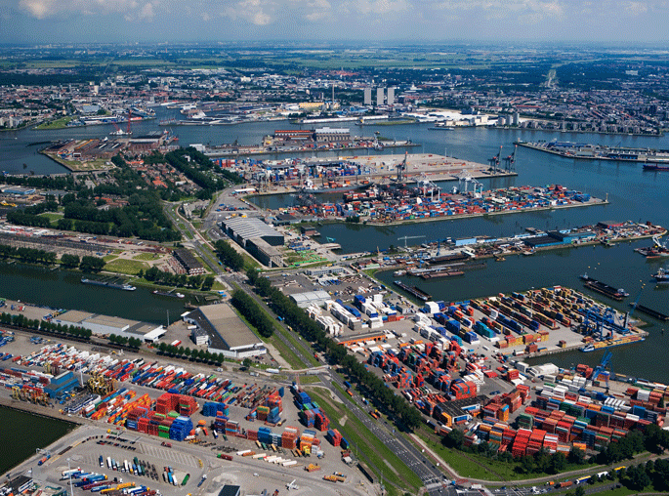
Rotterdam
Rotterdam is the EU’s largest port. Containers, packed with imported consumer goods, await transportation to cities in the EU.

Slide 6
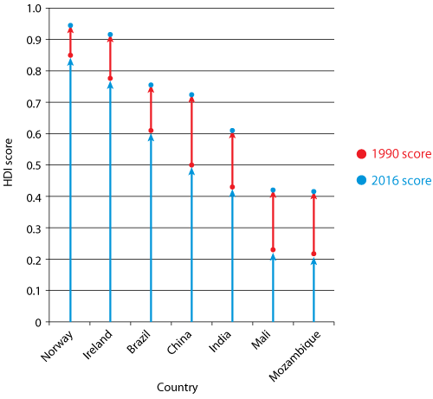
Improved HDI scores over time
Every country has shown an improvement over time
but some country scores are still very low

Slide 7
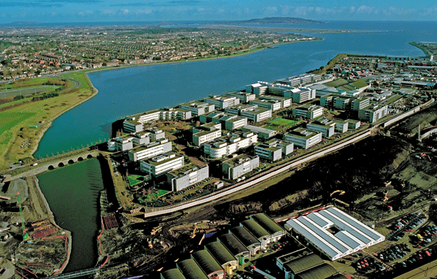
Business Parks
East Point Business Park where many office workers are employed
by large companies in the tertiary sector

Slide 8
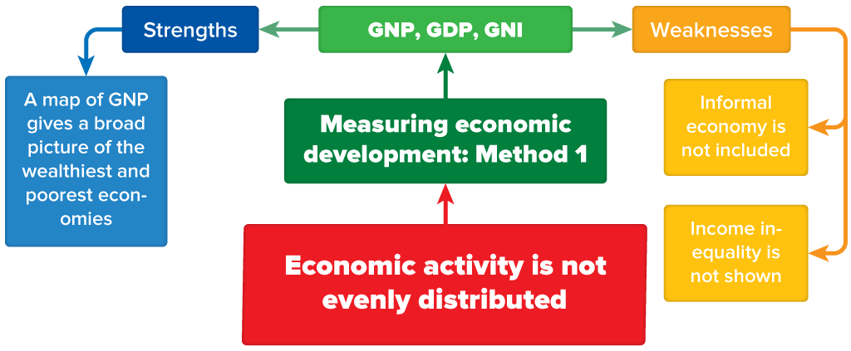
Summary Chart

Slide 9
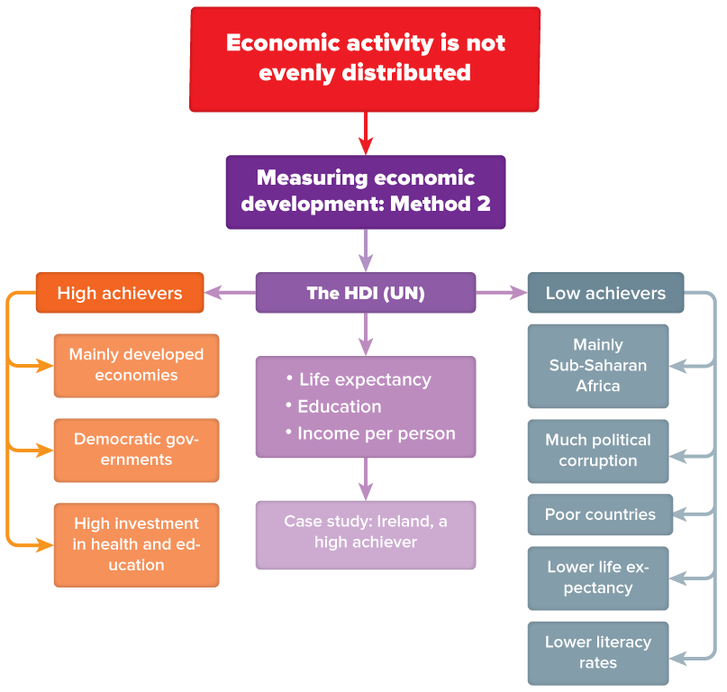
Summary Chart

Slide 10
Alamy
Compuscript

