Slide 1
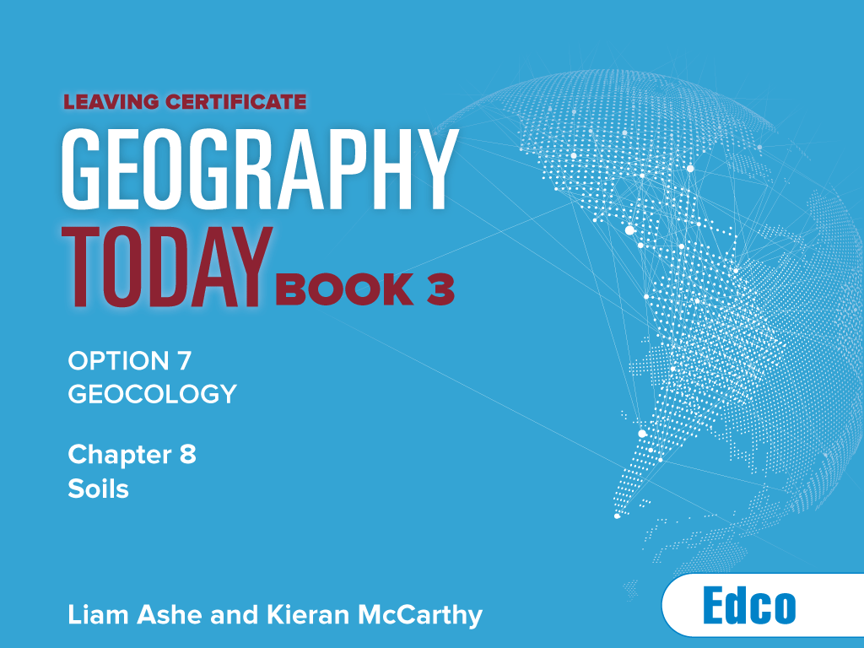

Slide 2
KEYWORDS
soil soil composition mineral particles parent material air water organic matter pore spaces plant litter micro-organisms organic matter humus | soil profile soil horizon bedrock soil texture soil structure pH value soil moisture soil colour topography weathering erosion | humification leaching podzolisation laterisation salinisation calcification zonal soils brown earths latosols intrazonal soils azonal soils | soil degredation desertification Sahel overgrazing overcropping deforestation soil conservation Great Green Wall agroforestry bunds zai holes

Slide 3
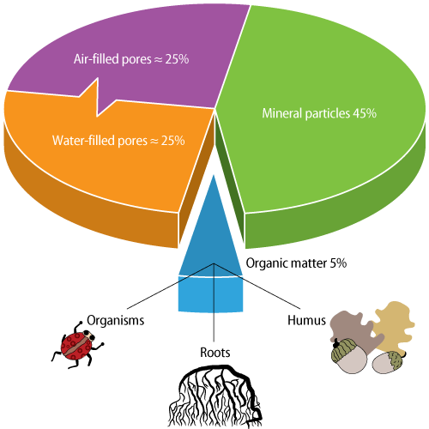
Composition of soil
The composition of a typical soil

Slide 4
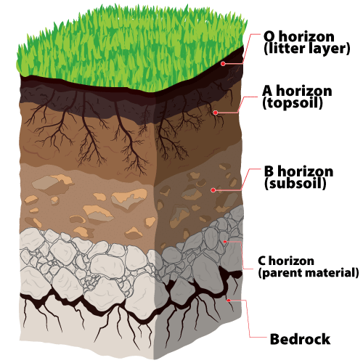
Soil profile

Slide 5
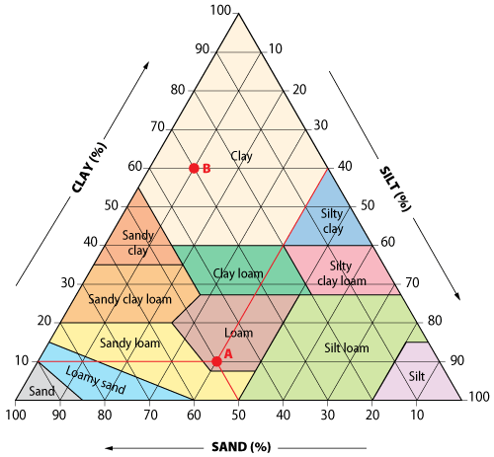
Soil texture
Soil texture is usually shown by a soil triangle

Slide 6
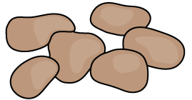
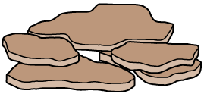
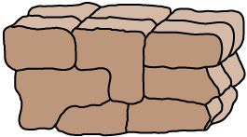
Three main soil structures
PED TYPE | SHAPE | DESCRIPTION
Crumb |  | This structure is granular. It consists of small rounded grains, like breadcrumbs, that lie loosely on the surface and are easily broken apart. This is the most common type of structure. It is excellent for drainage and air movement.
Platy |  | This structure consists of thin, flat particles that often overlap horizontally. It is usually found in clay soils that have been compacted. Platy structure tends to impede the downward movement of water and plant roots through the soil.
Blocky |  | This structure consists of cube-shaped particles that fit very tightly together. Blocky structure is most common in the B horizon. It allows for moderate drainage.

Slide 7
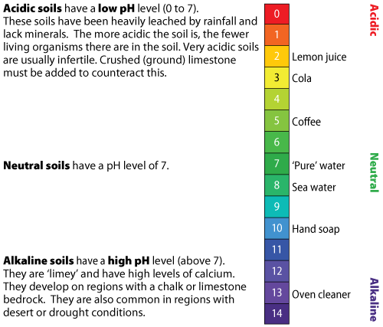
Soil pH
The soil pH table is logarithmic

Slide 8
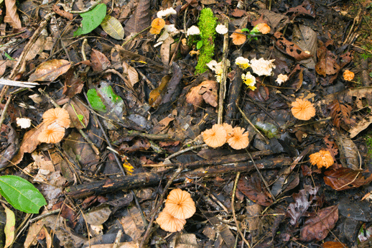
Humus in soil
Organic matter is broken down to form humus

Slide 9
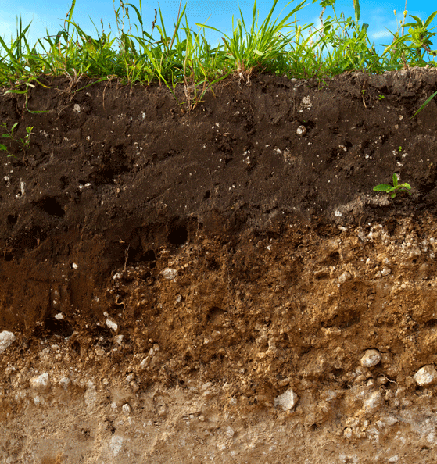
Influences on soil formation
Parent material
Mineral content
Texture
Drainage
Topography
Altitude
Gradient
Aspect
Soil
Living organisms
Recycling nutrients
Aeration and mixing
Organic matter
Climate
Weathering
Precipitation
Temperature
Time
Soil thickness
The factors that influence soil formation

Slide 10
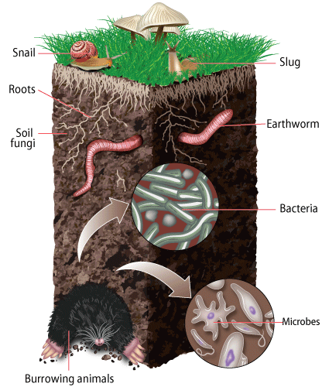
Living organisms
Organisms influence the structure and fertility of soil

Slide 11
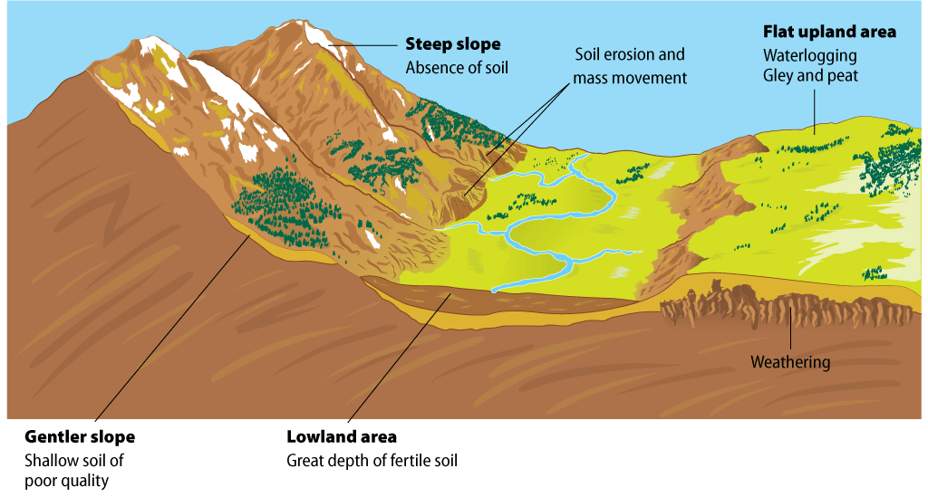
Topography
Topography influences the formation of soil

Slide 12
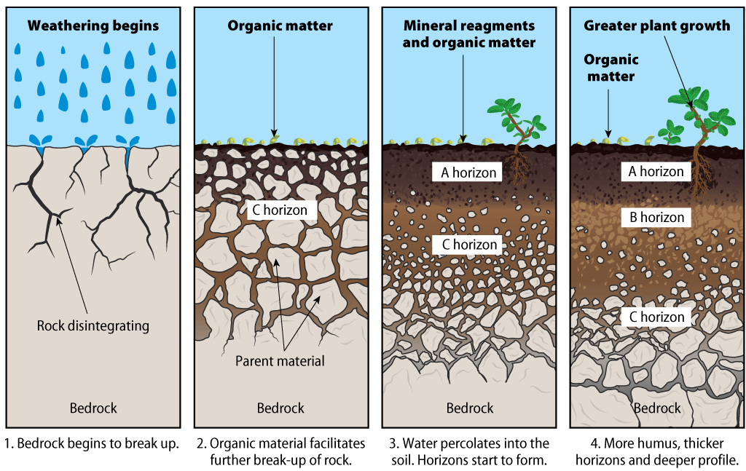
Time
Soil develops slowly over time

Slide 13
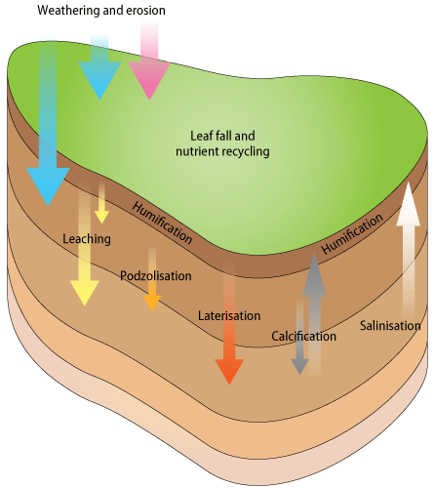
Processes of soil formation
Soil-forming processes

Slide 14
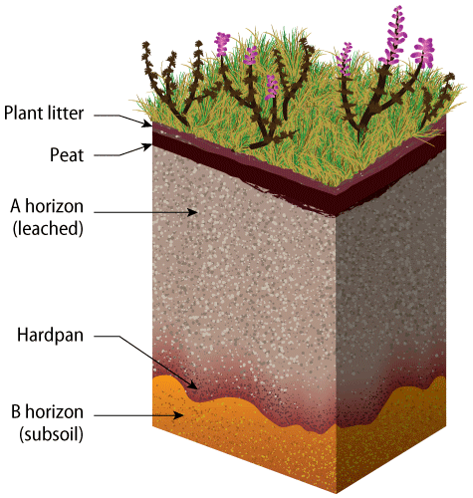
Podzolisation
Soil profile of a podzol soil

Slide 15
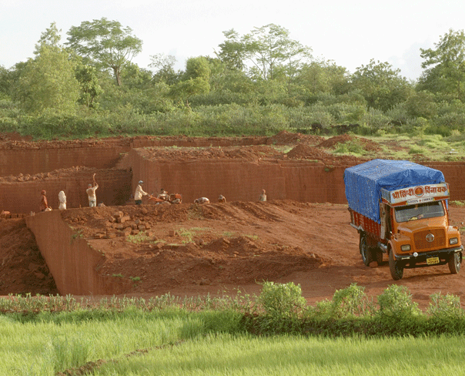
Laterisation
Latosol soils get their red colour from iron oxide (rust)

Slide 16
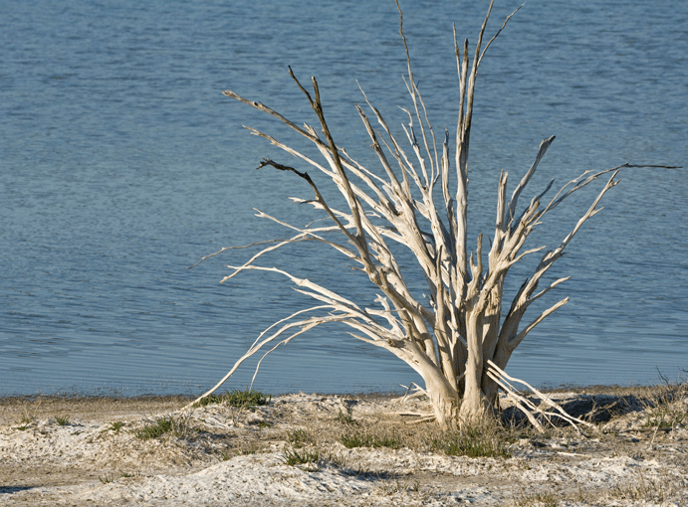
Salinisation
A crust of salt may accumulate near the surface

Slide 17
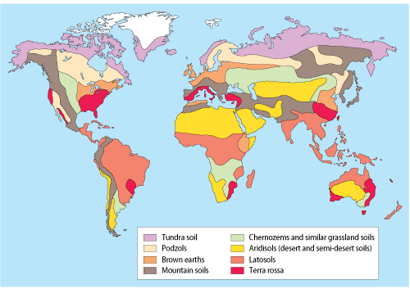
Zonal soils
The zonal soil most likely to be found in a region

Slide 18
Zonal soils
ZONAL SOIL | CLIMATE | VEGETATION
Latosols | Tropical/equatorial | Tropical rainforest
Aridosols | Desert | Desert
Terra rossa | Warm temperature maritime | Mediterranean
Brown earths | Cool temperature maritime | Mixed deciduous forest
Chernozems | Continental | Prairies/steppes
Podzols | Boreal (subarctic) | Coniferous forest (taiga)
Tundra | Tundra | Tundra
Zonal soils and the climate type they are linked with

Slide 19
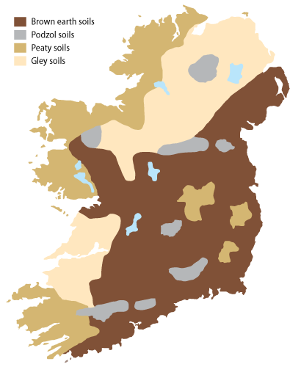
Soils of Ireland
General soil map of Ireland

Slide 20
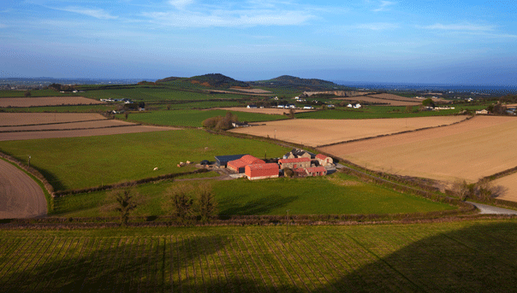
Brown earth soils
Brown earth soils support a wide range of farming types

Slide 21
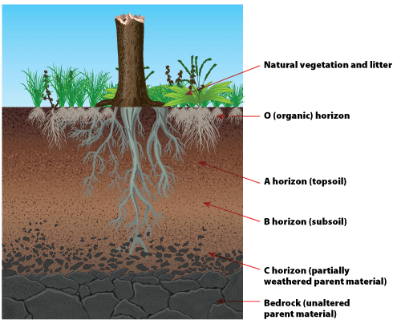
Profile of a brown earth soil
Brown earth soils support a wide range of farming types

Slide 22
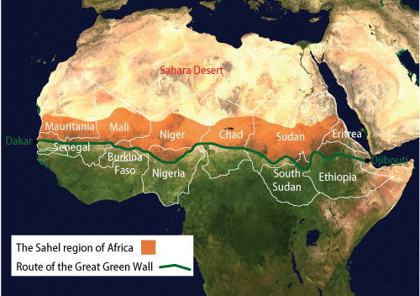
The Sahel and Green Wall
The arid land of the Sahel runs east-west across Africa

Slide 23
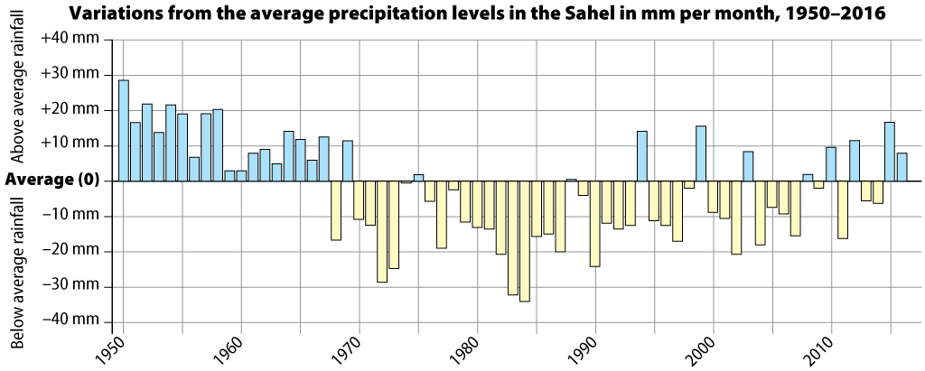
Precipitation in the Sahel
Variations in precipitation over time in the Sahel

Slide 24
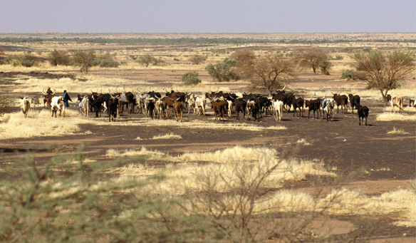
Overgrazing in the Sahel
Overgrazing has led to soil degradation in the Sahel

Slide 25
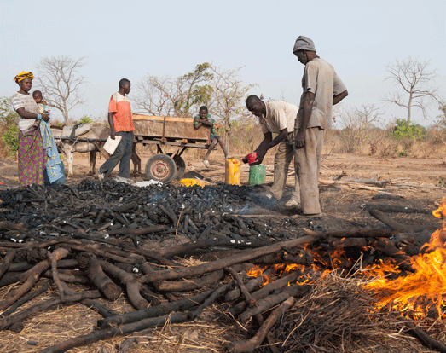
Deforestation in the Sahel
Charcoal is in demand as a fuel, especially for cooking

Slide 26
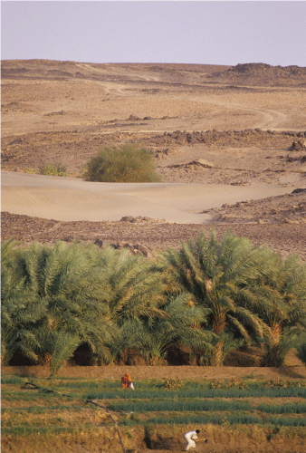
Agroforestry in the Sahel
Agroforestry is a combination of agriculture and forestry

Slide 27
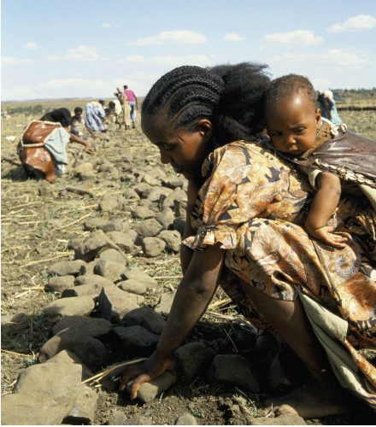
Soil conservation in the Sahel
Constructing bunds in Eritrea

Slide 28
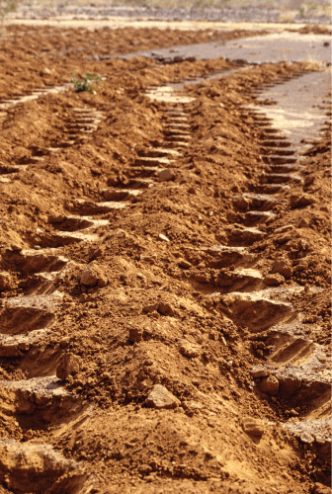
Soil conservation in the Sahel
Zai holes are planting pits

Slide 29
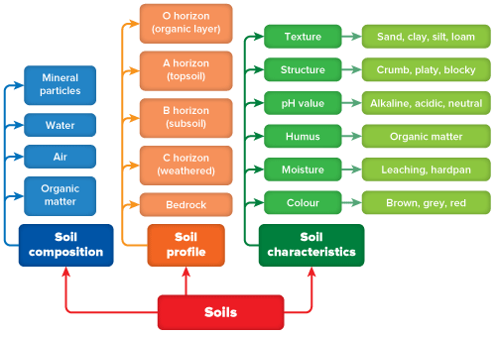
Summary chart

Slide 30
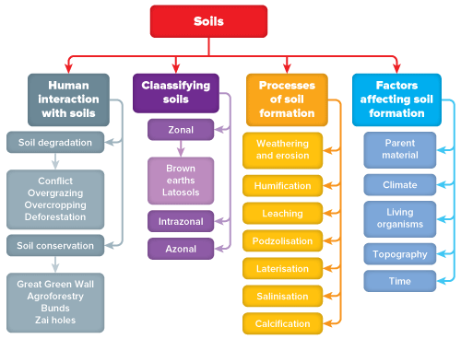
Summary chart

Slide 31
Compuscript
Alamy
Shutterstock
NASA

